Slide 1
Introduction to MVC
MVC pattern, ASP.NET MVC

Slide 2
Table of content
The MVC Design Pattern
Model, View, Controller
The MVC Pattern for Web and Examples
ASP.NET MVC
Overview
ASP.NET MVC Advantages
Creating first ASP.NET MVC Project

Slide 3
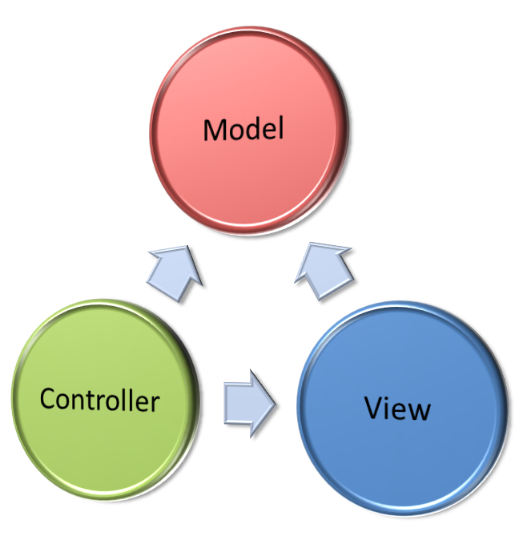
MVC Design pattern

Slide 4
MVC design pattern
Model–view–controller (MVC) is a software architecture pattern
Originally formulated in the late 1970_{s} by Trygve Reenskaug as part of the Smalltalk
Code reusability and separation of concerns
Originally developed for desktop, then adapted for internet applications

Slide 5
Model
Set of classes that describes the data we are working with as well as the business
Rules for how the data can be changed and manipulated
May contain data validation rules
Often encapsulate data stored in a database as well as code used to manipulate the data
Most likely a Data Access Layer of some kind
Apart from giving the data objects, it doesn't have significance in the framework

Slide 6
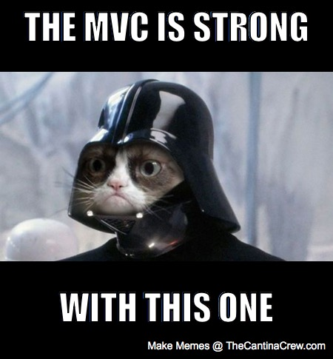
View
Defines how the application’s user interface (UI) will be displayed
May support master views (layouts) and sub-views (partial views or controls)
Web: Template to dynamically generate HTML

Slide 7
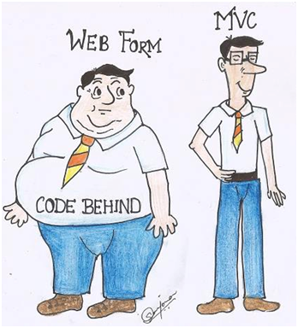
Controller
The core MVC component
Process the requests with the help of views and models
A set of classes that handles
Communication from the user
Overall application flow
Application-specific logic
Every controller has one or more "Actions"

Slide 8
MVC in the web
Incoming request routed to Controller
For web: HTTP request
Controller processes request and creates presentation Model
Controller also selects appropriate result (view)
Model is passed to View
View transforms Model into appropriate output format (HTML)
Response is rendered (HTTP Response)

Slide 9


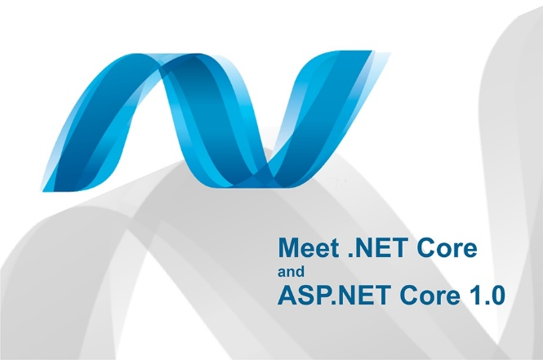
ASP.NET History
Classic ASP introduced in late 1990's
ASP.NET 1.0 – 2002 (Web Forms)
ASP.NET 3.5 – 2008 (First version of MVC)
Two more versions in next two years
ASP.NET 4 – 2010 (VS 2010, MVC 2.0, Razor)
ASP.NET 4.5 (First version of Web API, VS 2012)
February 2013 – SignalR
Autumn 2013 – VS 2013, One ASP.NET, MVC 5
ASP.NET vNext – 2014, Roslyn, Platform ind.
ASP.NET CORE MVC - 2015

Slide 10
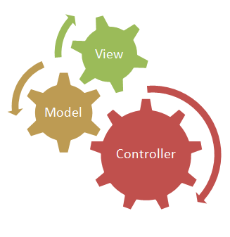
ASP.NET MVC
Runs on top of ASP.NET
Not a replacement for WebForms
Leverage the benefits of ASP.NET
Caching, modules, handlers, session state, …
Embrace the web
No illusions of state – no page lifecycle
User/SEO friendly URLs, clean HTML 5, SPA
Adopt REST concepts
Uses MVC pattern
Conventions and Guidance
Separation of concerns

Slide 11
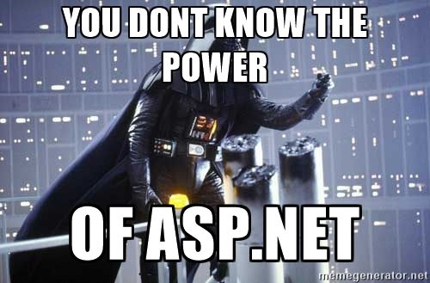
ASP.NET MVC
Tight control over markup
Testable
Loosely coupled and extensible
Convention over configuration
Razor view engine
One of the greatest view engines
With intellisense, integrated in Visual Studio
Reuse of current skills (C#, EF, LINQ, JS, etc.)
Application-based (not scripts like PHP)

Slide 12
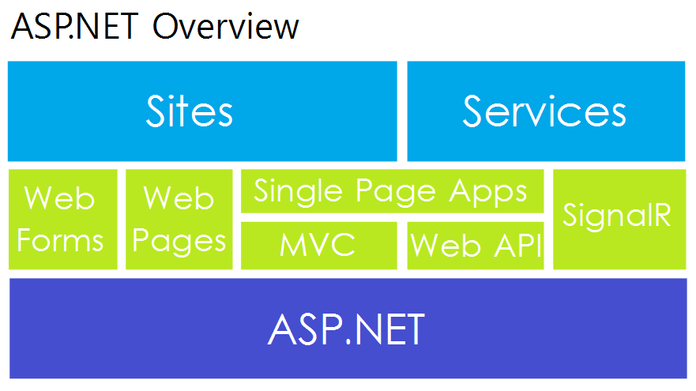
One ASP.NET
Web Forms
Component-based
ASP.NET MVC
Web Pages
Lightweight framework for dynamic content
Web API
Framework for building RESTful Web services
SignalR
Real-time client-server communication

Slide 13
Extensible
Replace any component of the system
Interface-based architecture
Almost anything can be replaced or extended
Model binders (request data to CLR objects)
Action/result filters (e.g. OnActionExecuting)
Custom action result types
View engine (Razor, WebForms, NHaml, Spark)
View helpers (HTML, AJAX, URL, etc.)
Custom data providers (ADO.NET), etc.
Controller factory can be also replaced

Slide 14
Clean URL
REST-like
/products/update
/blog/posts/2013/01/28/mvc-is-cool
Friendlier to humans
/product.aspx?catId=123 or post.php?id=123
Becomes /products/chocolate/
Friendlier to web crawlers
Search engine optimization (SEO)

Slide 15

NUGET Package management
Free, open source package management
Makes it easy to install and update open source libraries and tools
Part of Visual Studio 2012/2013 / 2015 / 2017
Configurable package sources
Simple as adding a reference
GUI-based package installer
Package manager console

Slide 16
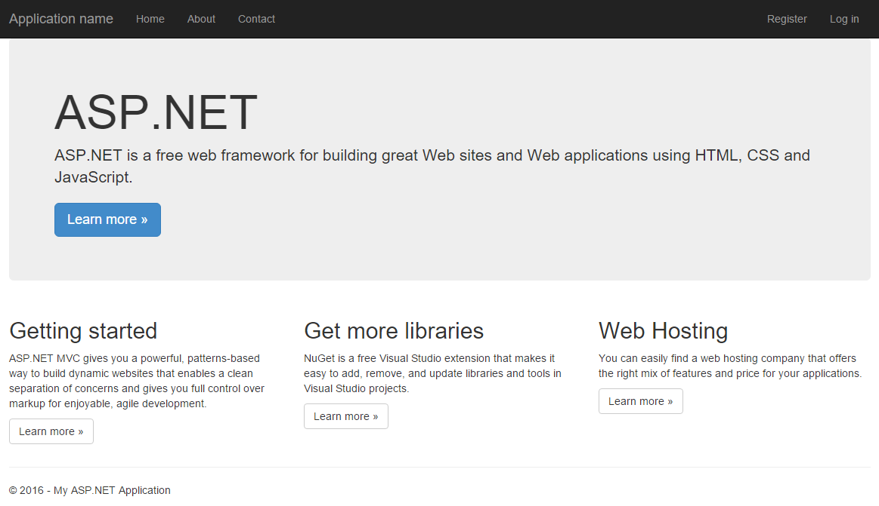
Create ASP.NET MVC project
Visual studio 2015

Slide 17
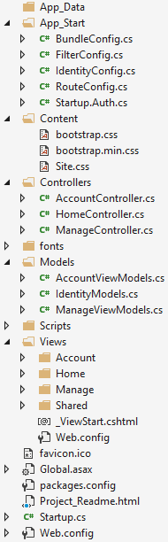
ASP.NET MVC Project structure
Static files (CSS, fonts, images, etc.)
All controllers and actions
Models (view models) are located in the Models folder
JavaScript files (jQuery, Modernizr, knockout, etc.)
Razor View templates (cshtml files)
Shared folder contains common views like:
_Layout.cshtml – master page (main template)
Application_Start() – The entry point of the application
Web.config – Configuration file

Slide 18

Any questions

